Slide 1
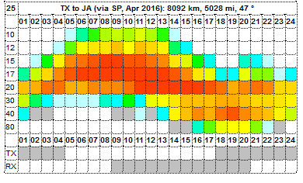
VOACAP Propagation Planner v2.0b
http://www.voacap.com/planner.html

Slide 2
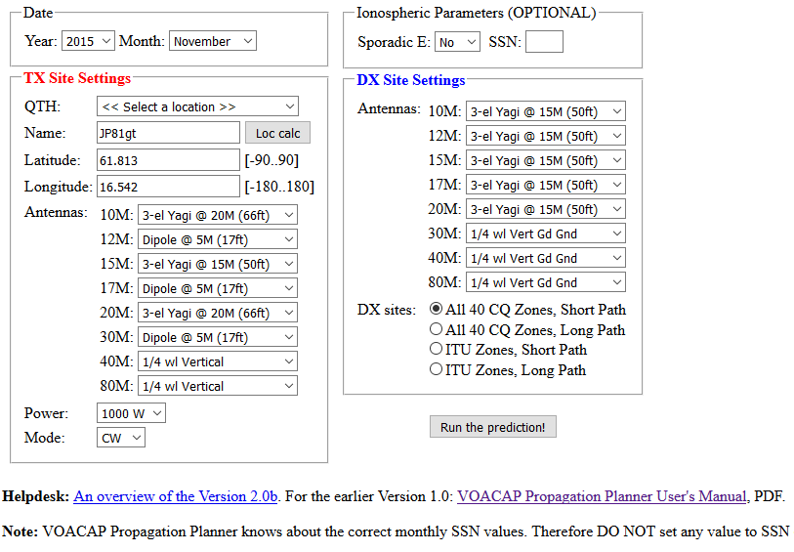
VOACAP Propagation Planner v2.0b
http://www.voacap.com/planner.html

Slide 3
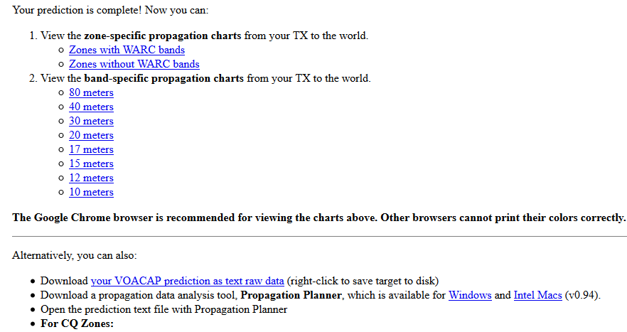
VOACAP Propagation Planner v2.0b
Download this Excel workbook [Office 2010 and later] or [Office 2003 and earlier], and copy the band-specific predictions from Propagation Planner to their corresponding tabs (80...10) in the workbook. The 40+ CQ Zone summary tabs will be populated automatically!

Slide 4
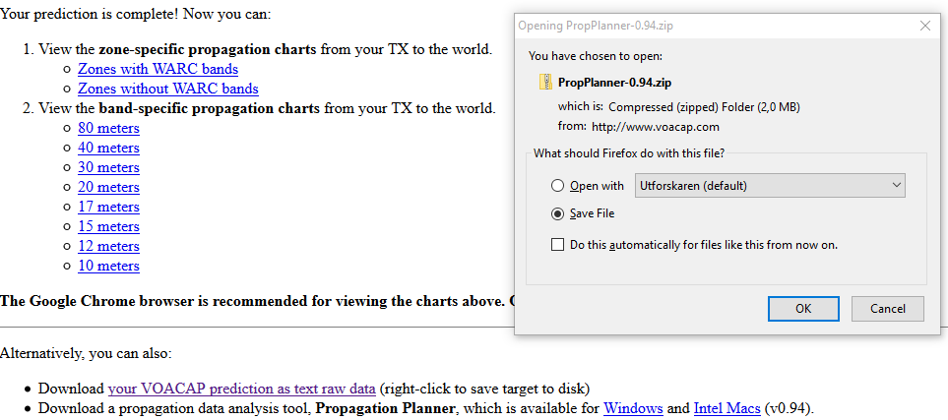
VOACAP Propagation Planner v2.0b

Slide 5
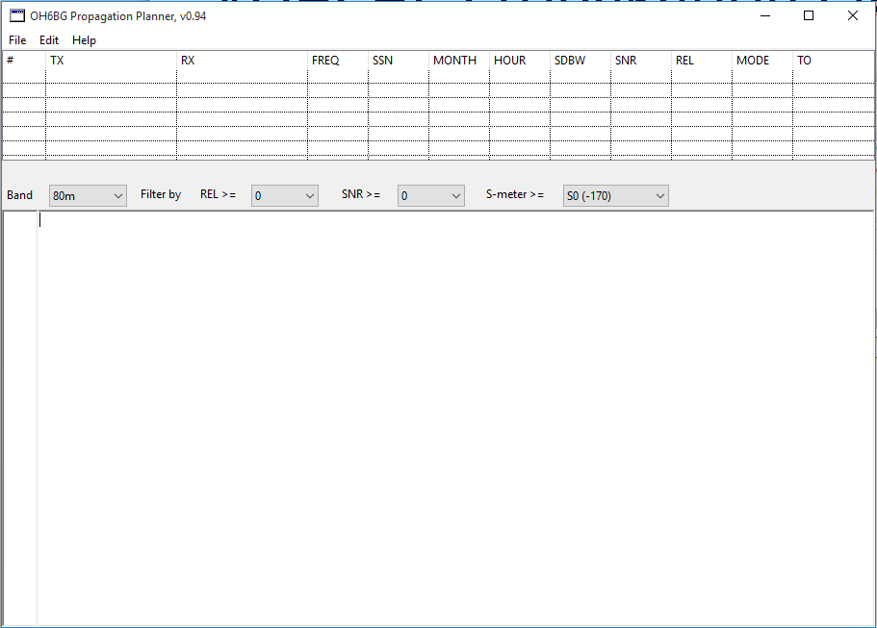
VOACAP Propagation Planner v2.0b

Slide 6
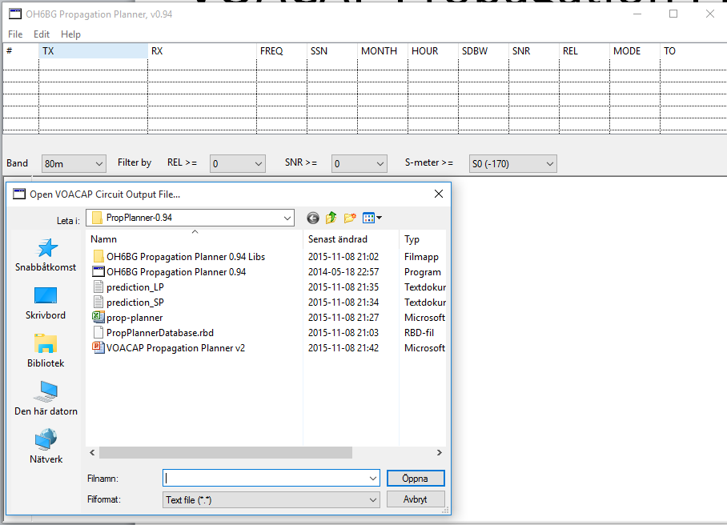
VOACAP Propagation Planner v2.0b

Slide 7
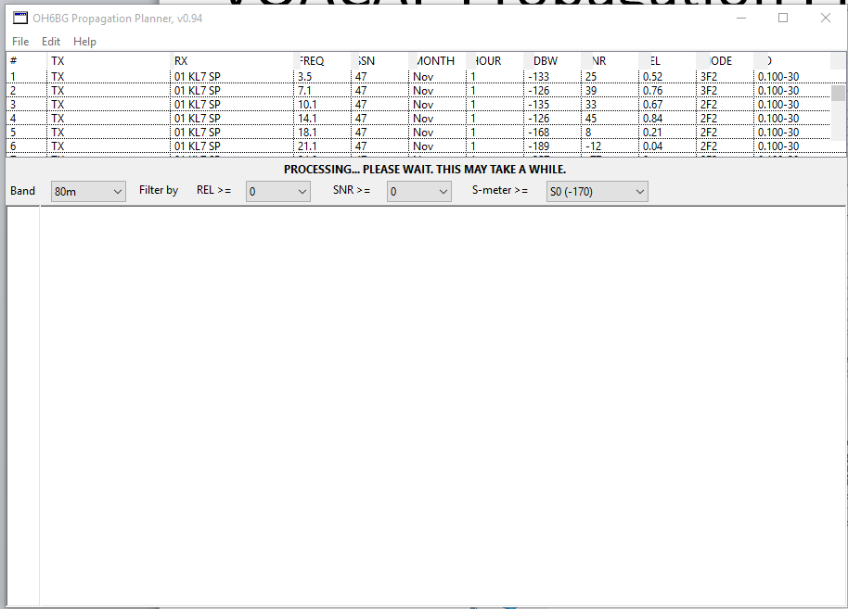
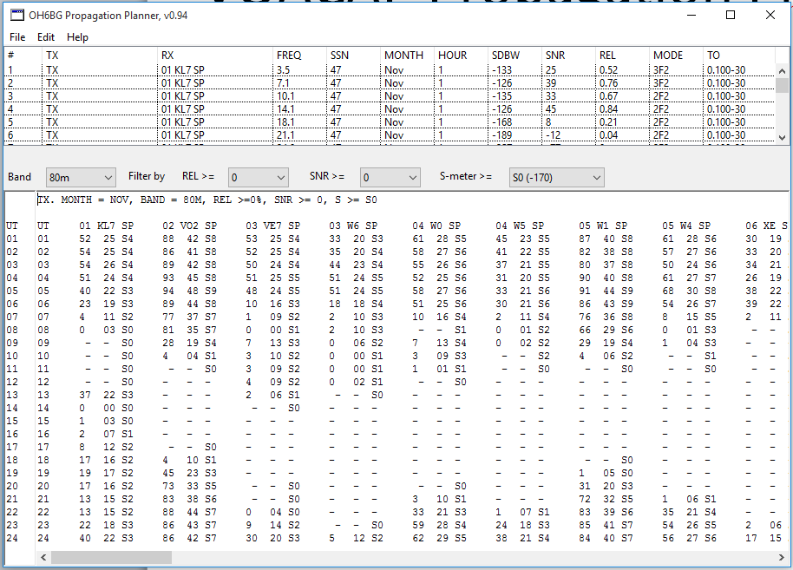
VOACAP Propagation Planner v2.0b

Slide 8
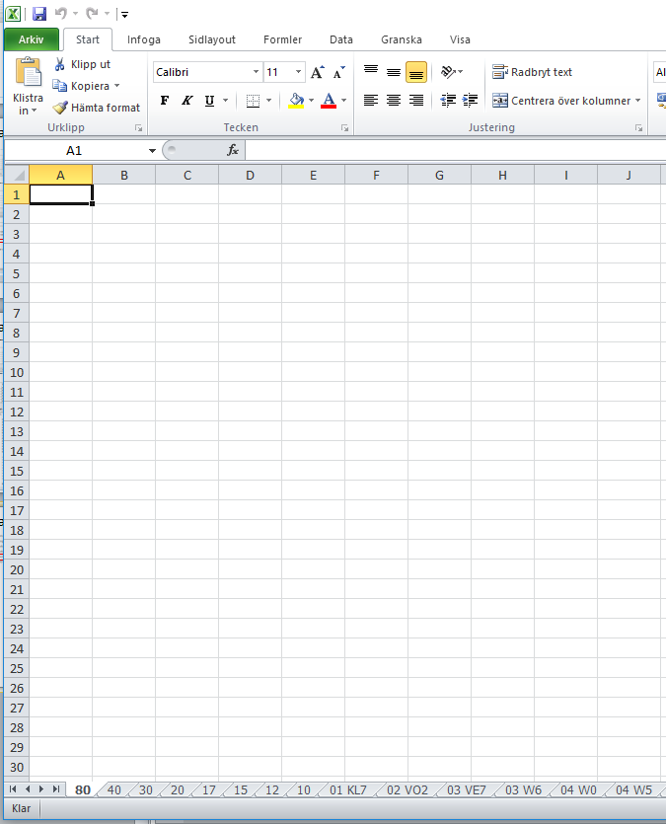
VOACAP Propagation Planner v2.0b

Slide 9
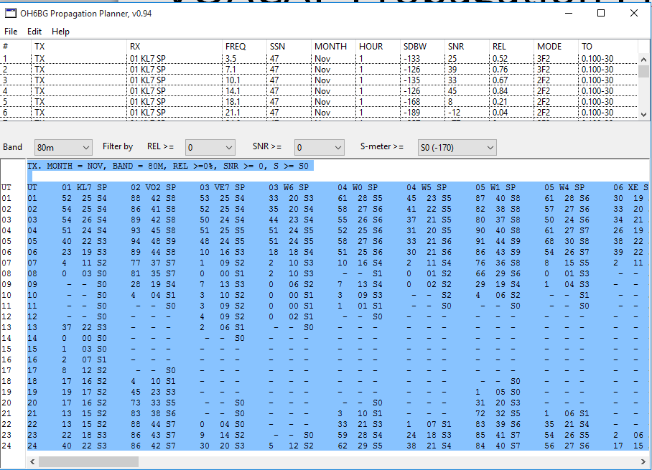
VOACAP Propagation Planner v2.0b
Ctrl A
Ctrl C

Slide 10
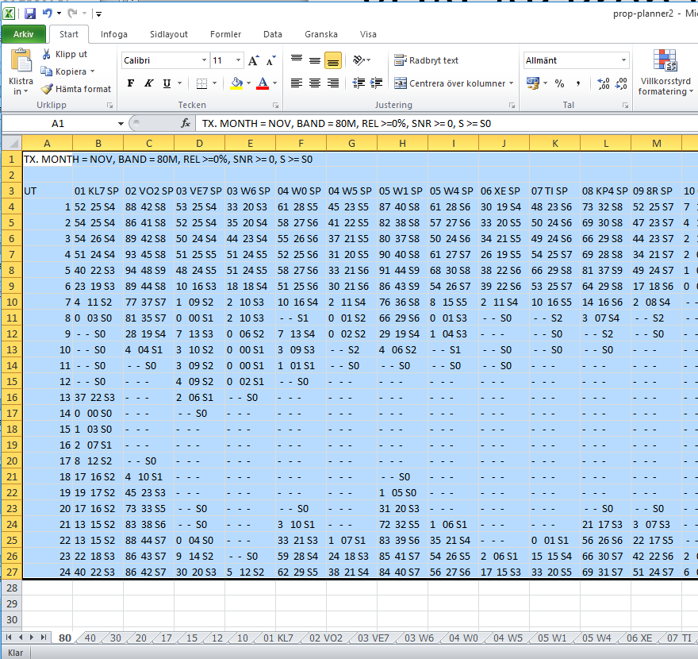
VOACAP Propagation Planner v2.0b
Ctrl V

Slide 11
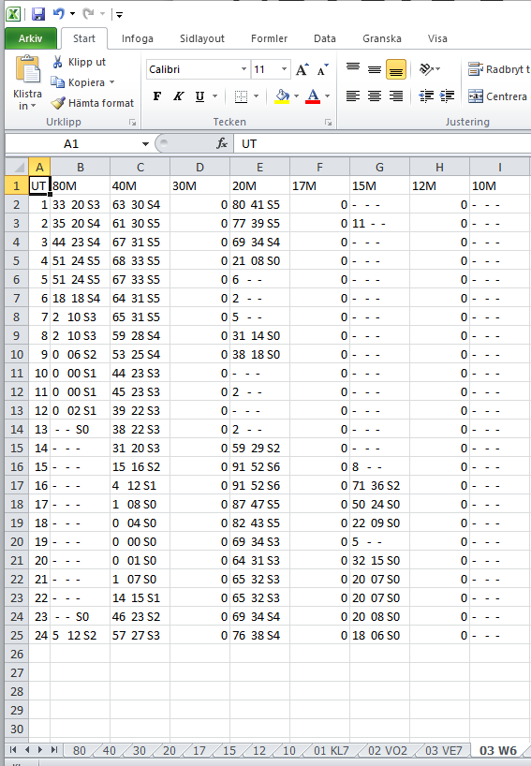
VOACAP Propagation Planner v2.0b

Slide 12
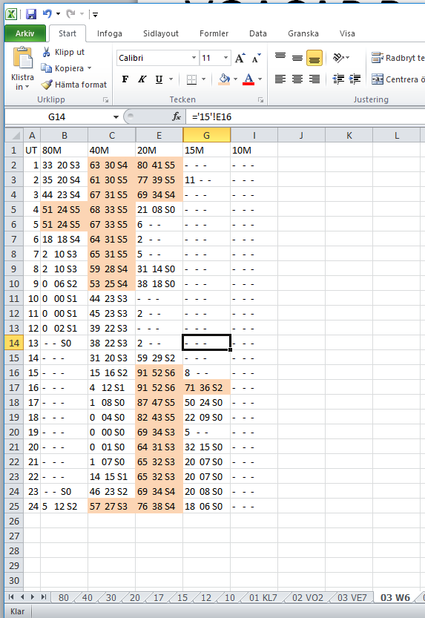
VOACAP Propagation Planner v2.0b

Slide 13
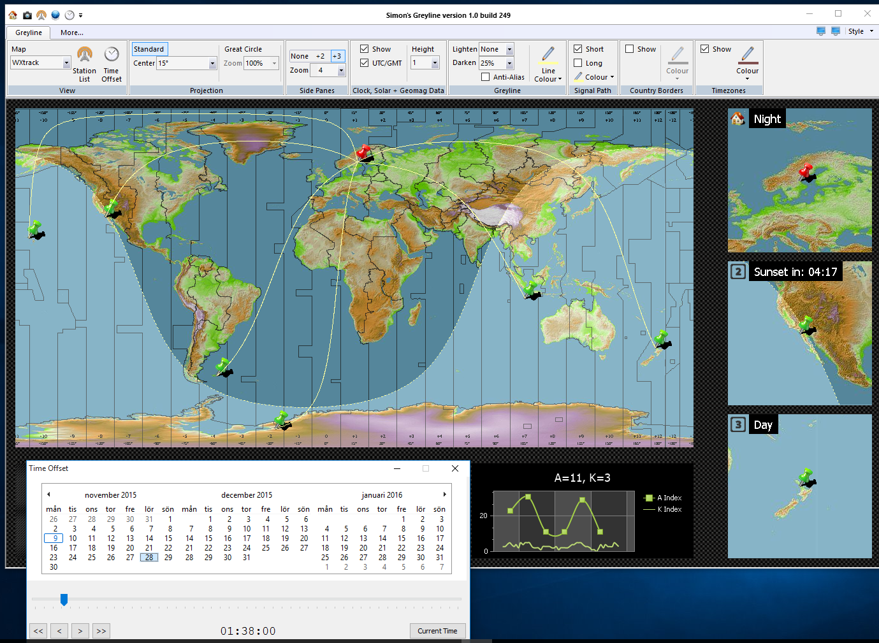
VOACAP Propagation Planner v2.0b

Slide 14
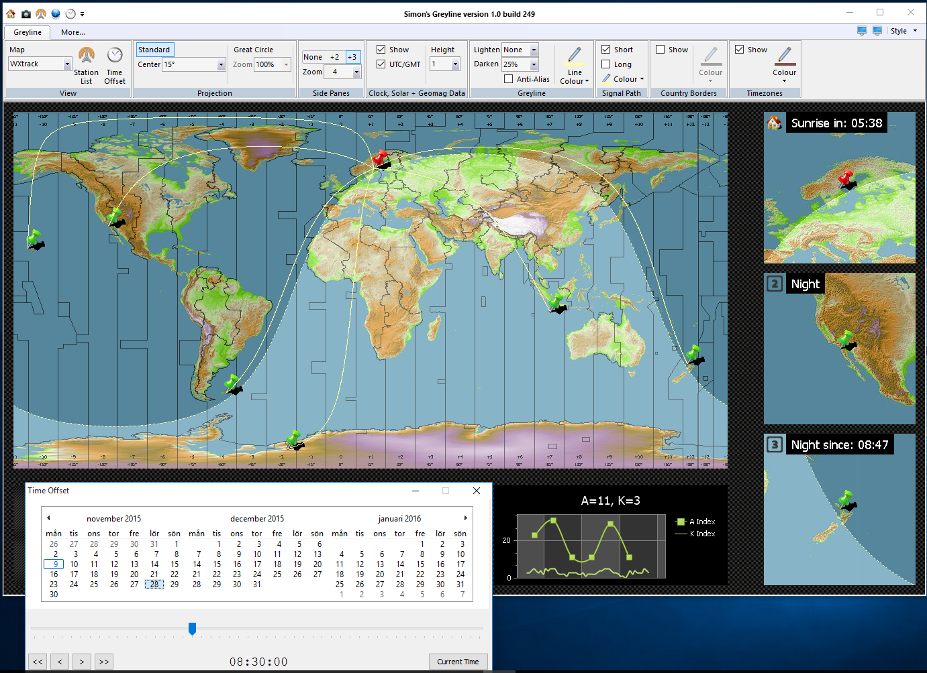
VOACAP Propagation Planner v2.0b

Slide 15
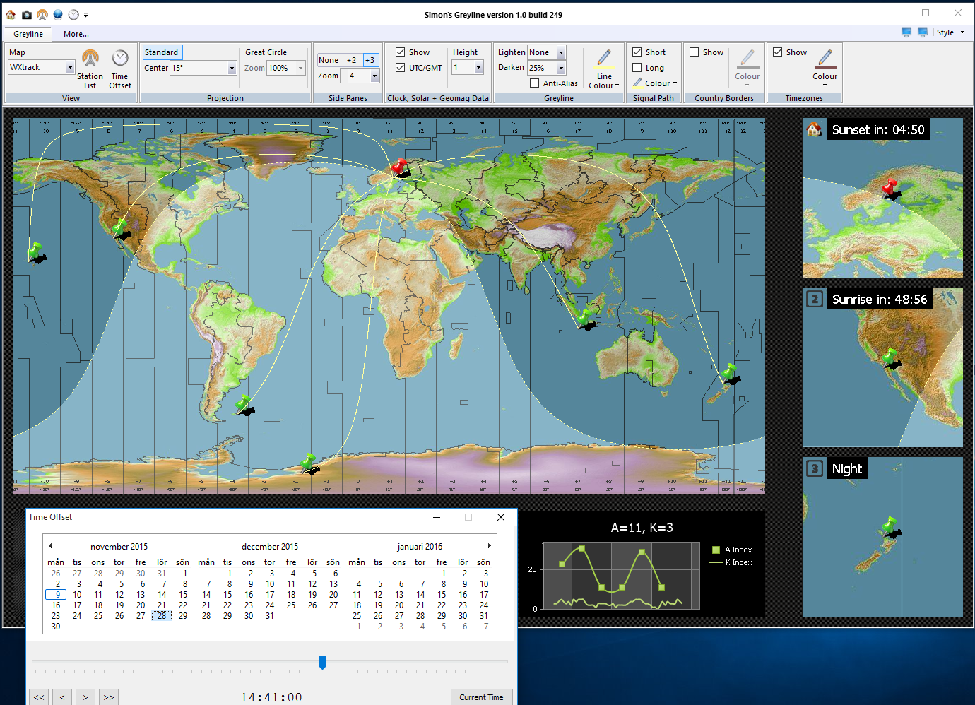
VOACAP Propagation Planner v2.0b

Slide 16
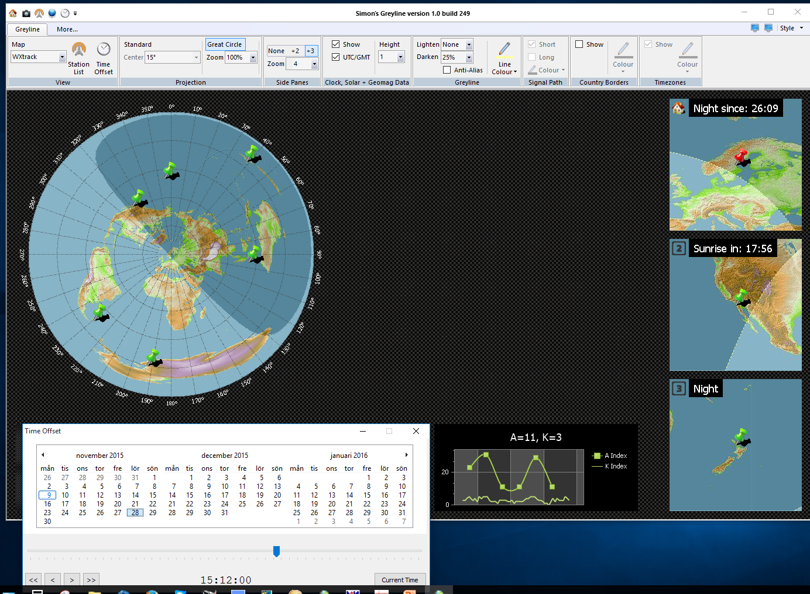
VOACAP Propagation Planner v2.0b

Slide 17
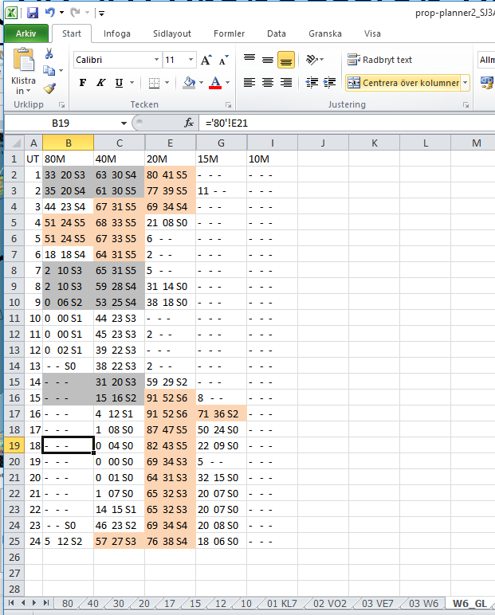
VOACAP Propagation Planner v2.0b

